Slide 1

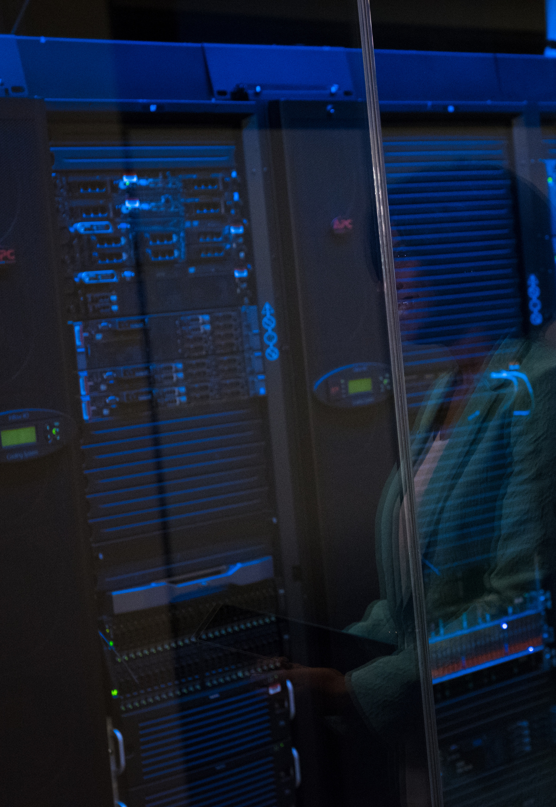

Safe Space
Pitch Deck
Team V

Slide 2
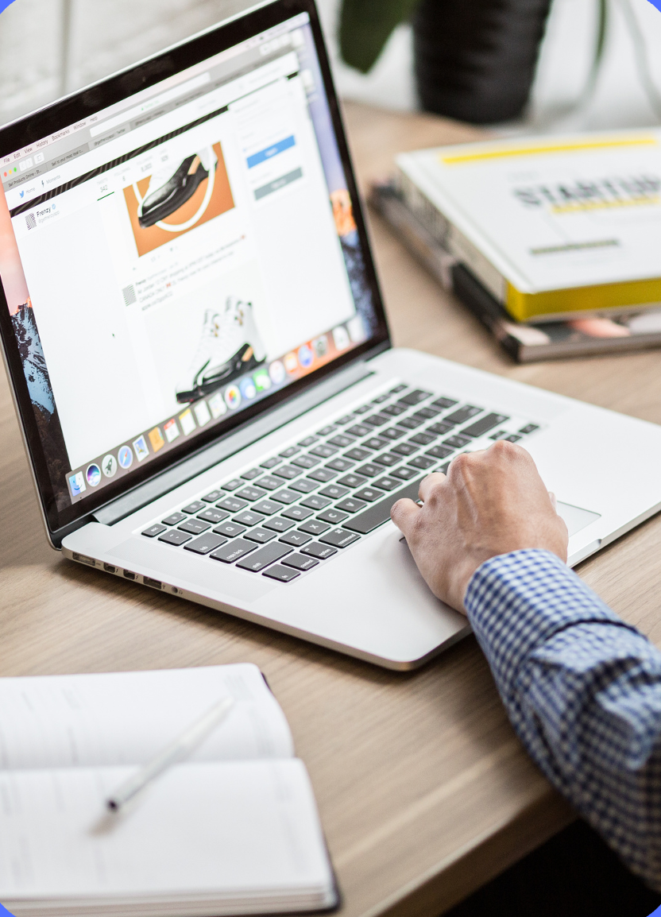
“Our project aims to enhance password security.“
Steeve Tassy

Slide 3
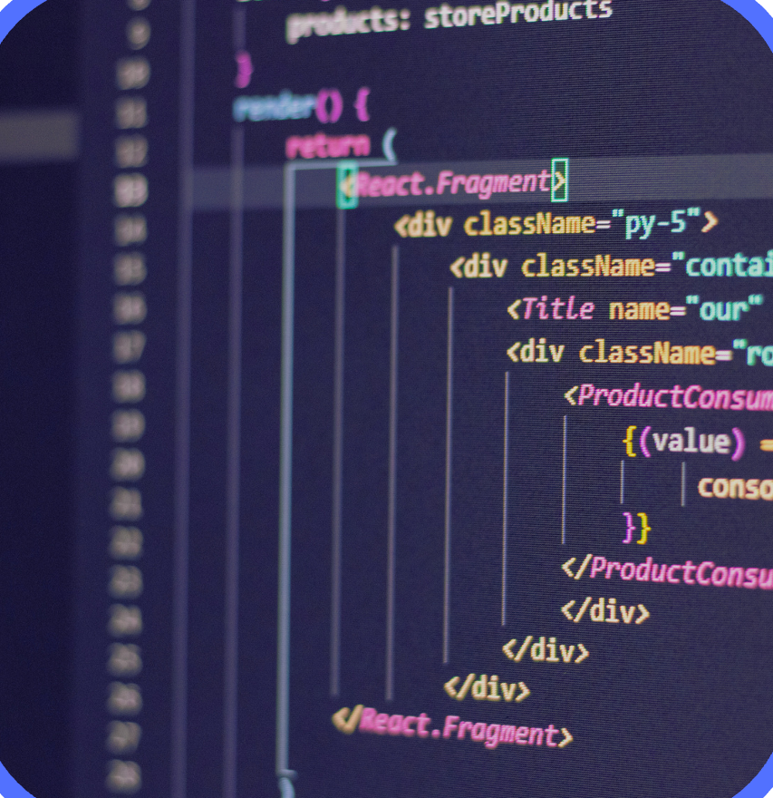
Cost of Cyberattacks
Forecasts show businesses will lose approximately $10.5 trillion in 2025 at an estimated $19,977,168 per minute due to cybercrime.

Slide 4

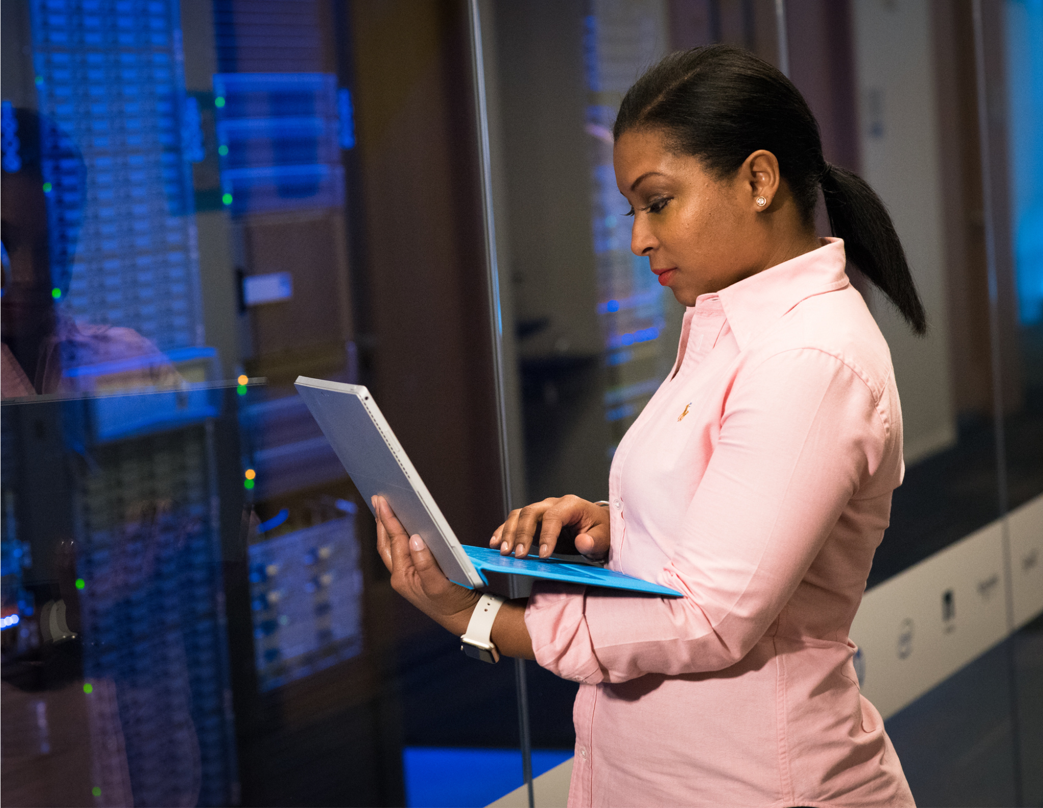
According to sources, nearly 95% of all digital breaches come from human error.

Slide 5
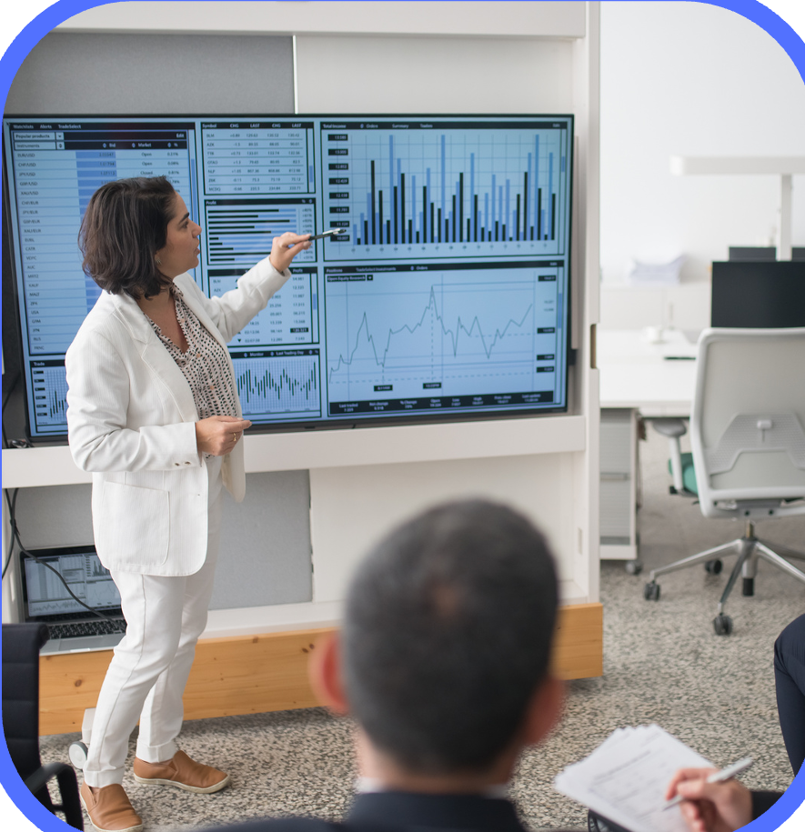
What we bring?
Safe Space is an algorithm in Java that checks the strength of your passwords and suggests strong ones."

Slide 6
Cybersecurity In Numbers
23%
86%
8.6%
Global cybercrime costs are predicted to grow over the next 5 years
Majority of cyberattacks are motivated by financial gain
Is what publics companies loose of their value after a cyber breach.
*estimate

Slide 7
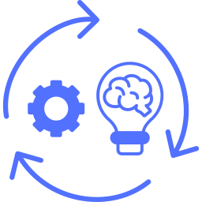
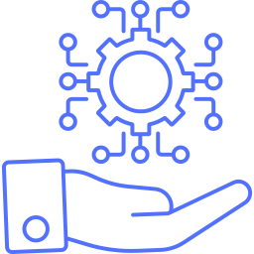
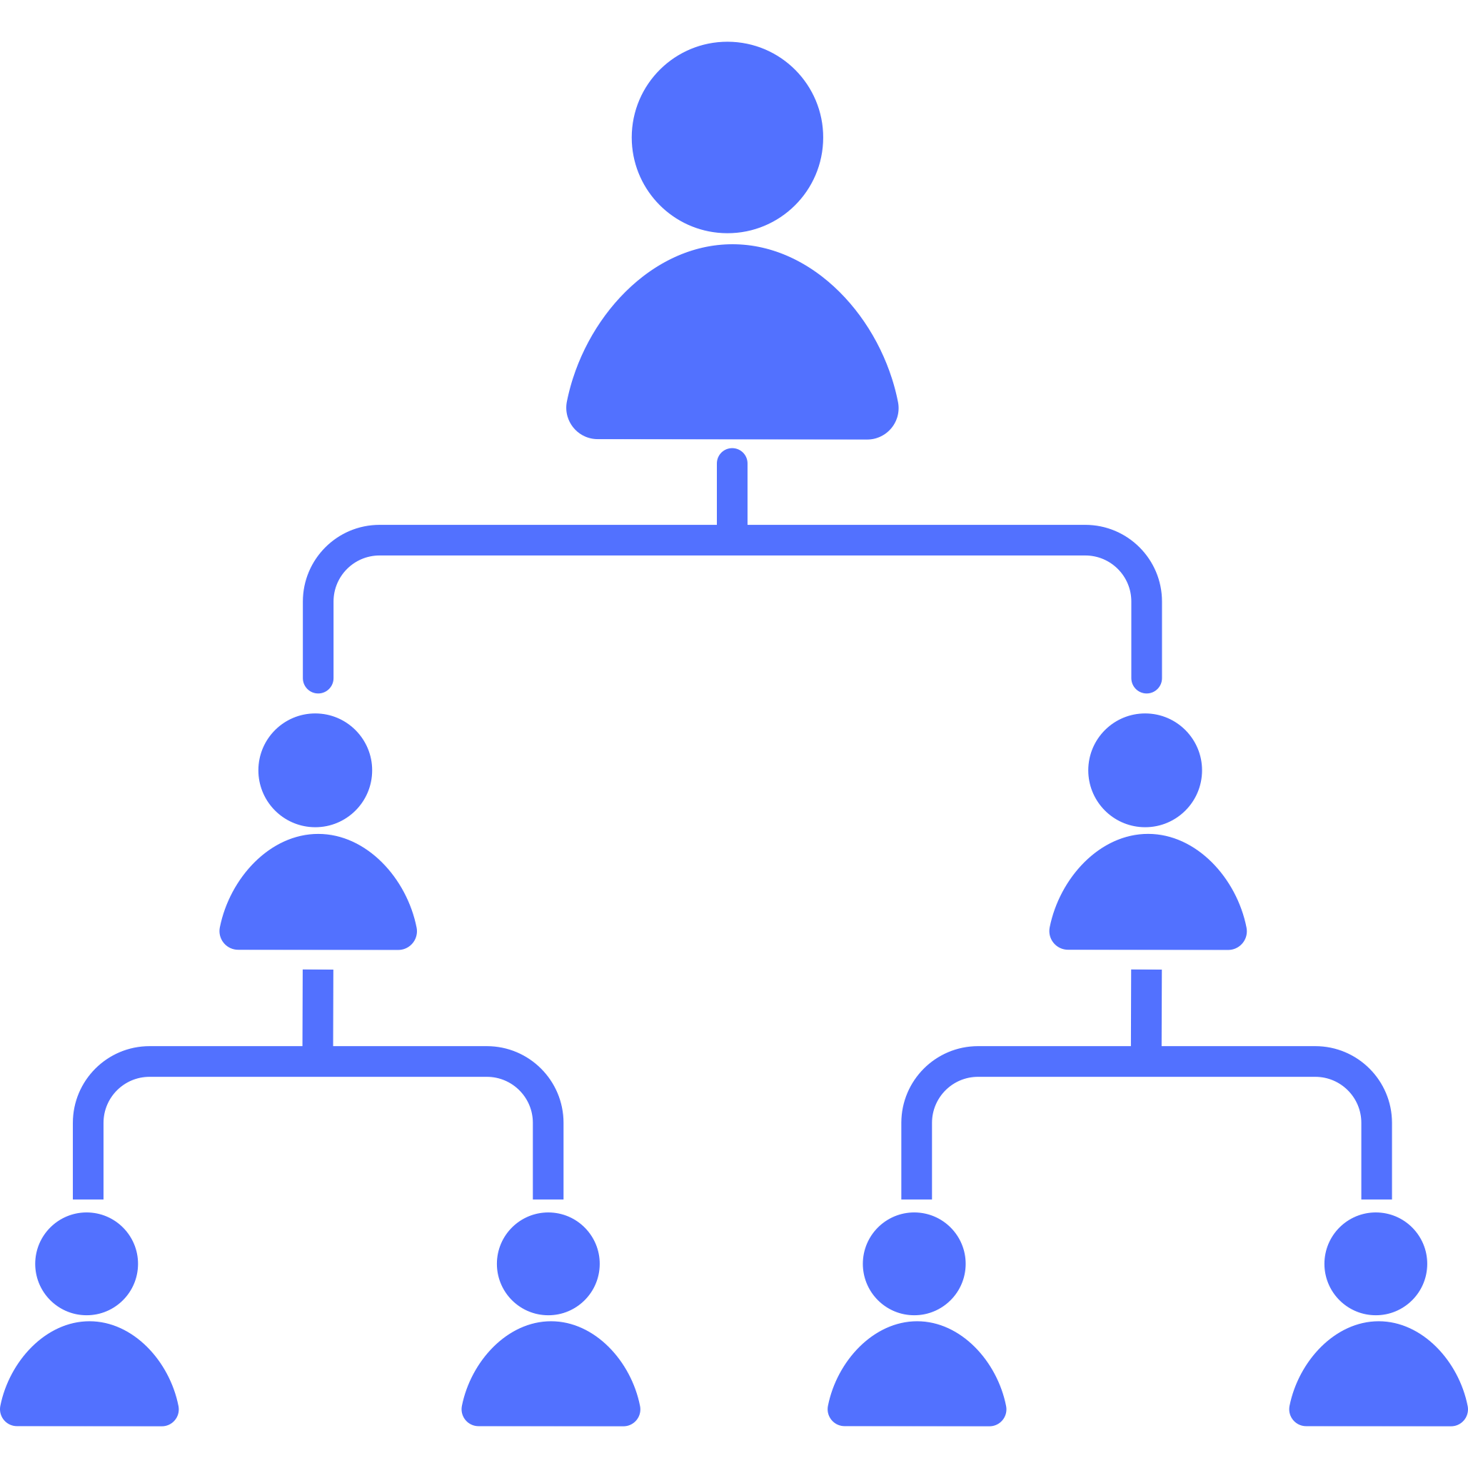
Password Strength Checker and Generator
Strength Assessment
Generation
User-Friendly Interface
Evaluate the strength of a given password.
Generate strong and secure passwords.
Accessible to a wide range of users.

Slide 8
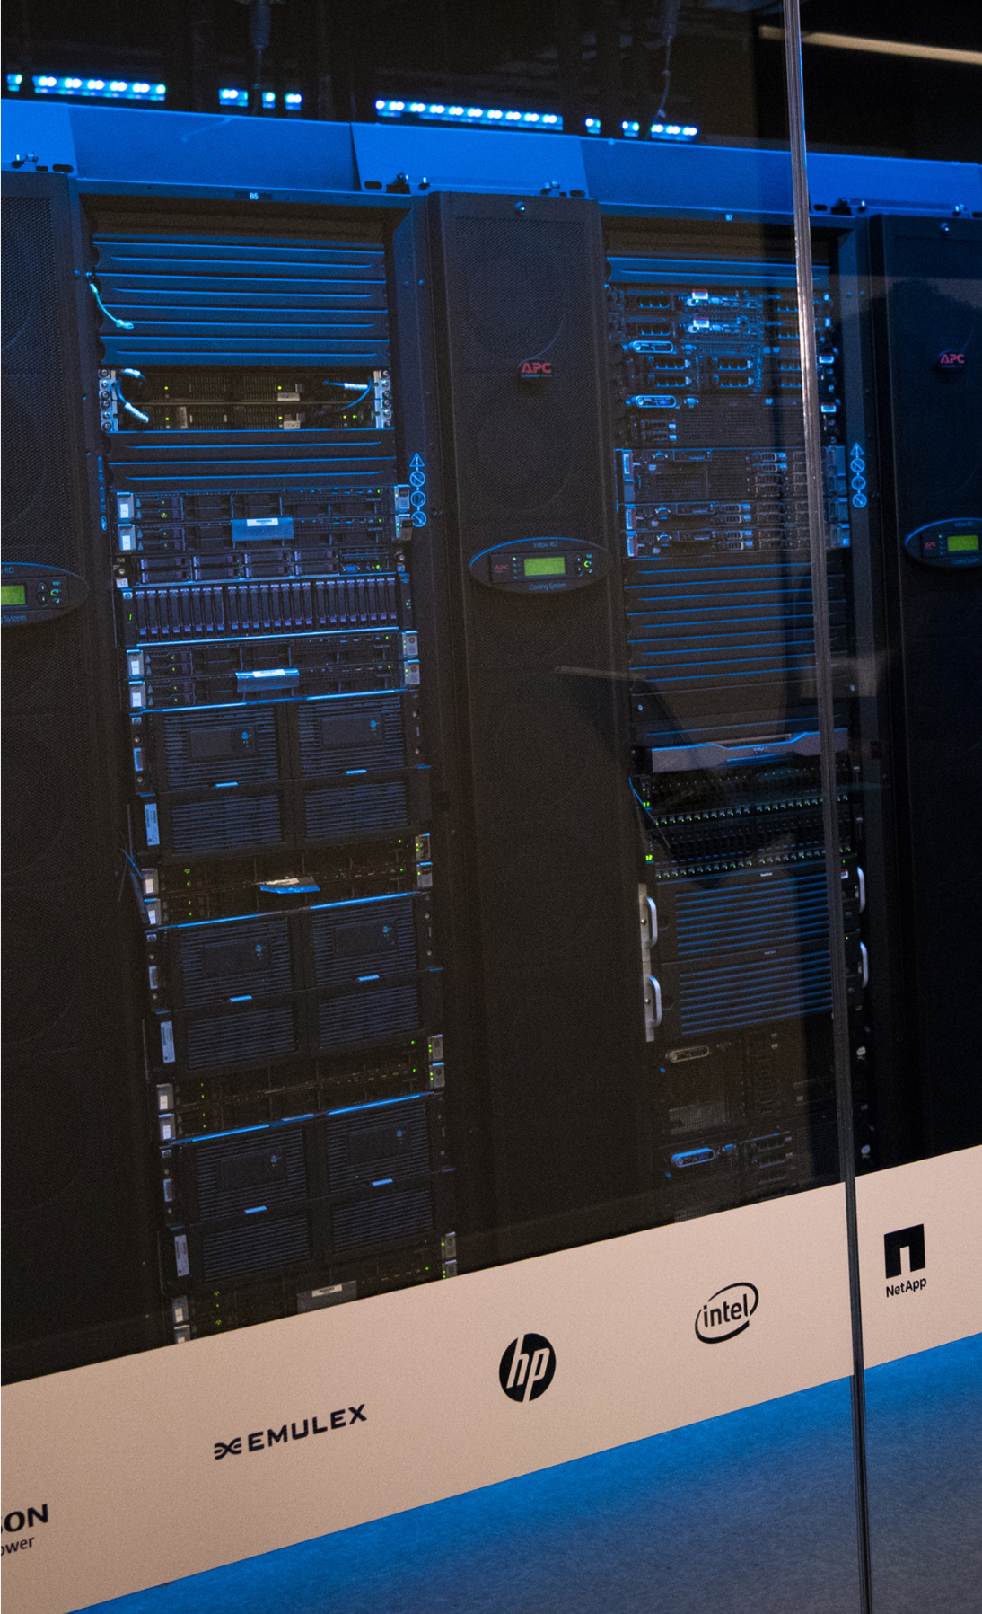

No more forgetting or resetting passwords; PassGen stores and autofills them for you.
Safe Space Benefits
Enhanced Security
Convenience
Protect your online presence with unbreakable passwords.
No more forgetting or resetting passwords
Time-Saver
Peace of Mind
Generate and manage passwords with a few taps.
Your data is safe and secure by the calculations of our algorithm

Slide 9
Challenges and Issues
Technical Challenges:
Overcoming technical hurdles and ensuring that systems work as intended.
Team Dynamics
Ensuring that team members work effectively together and stay motivated.
Scalability and Future-proofing
Preparing the project to adapt to future demands or changes.

Slide 10
Potential Features
Strong Passwords Safe Space will generate complex passwords using a variety of characters and ensures they meet the highest security standards. | Customization You can tailor passwords to fit specific requirements for different websites or services. | Password Vault Store all your passwords in one secure place, protected by robust encryption.
Biometric Lock Unlock Safe Space n with your fingerprint or Face ID for an added layer of security. | Password Sharing Safely share passwords with trusted individuals. | Auto-Fill Seamlessly auto-fill passwords in apps and browsers, making login a breeze.

Slide 11
We bring the power of strong, unique passwords at your fingertips!
- Safe Space -

Slide 12
Team V Thank you!
Adriano Crippa
Hardas Lee
Nissia Gansaore
Steeve Tassy

